Slide 1
Employee Data Analysis using Excel
STUDENT NAME:Hemalatha.M
REGISTER NO :312216942
DEPARTMENT :Commerce ( B. Com general)
COLLEGE : Shri krishnaswamy college for women

Slide 2
PROJECT TITLE
Salary & compensation Analyis through Excel data Modelling

Slide 3


AGENDA
Problem Statement
Project Overview
End Users
Our Solution and Proposition
Dataset Description
Modelling Approach
Results and Discussion
Conclusion
3/21/2024 Annual Review

Slide 4

PROBLEM STATEMENT
1.Define the Problem Statement:
Determine what specific aspects of salary and compensation you want to analyze. This could include salary distribution, gender pay gap, compensation vs. performance, etc.
2.Collect and Prepare Data:
Gather data on employee salaries, bonuses, benefits, job titles, departments, years of experience, etc.
Ensure data is clean and organized in a structured format (e.g., columns for employee ID, job title, salary, bonuses, etc.).

Slide 5

PROJECT OVERVIEW
Project Phases:Data Preparation:Data Collection: Collect raw salary and compensation data from HR systems.Data Cleaning: Clean and format the data to ensure accuracy and consistency.Data Integration: Merge data from different sources if necessary.
.

Slide 6

WHO ARE THE END USERS?
Human Resources (HR)
Compensation Analysts:
Finance Managers:
Professionals

Slide 7

OUR SOLUTION AND ITS VALUE PROPOSITION
Enhanced Accuracy: By using Excel data modeling, your solution ensures precise calculations and minimizes errors in salary and compensation analysis, leading to more reliable and accurate financial data.Data Visualization: Excel provides various tools for creating charts, graphs, and pivot tables, which help in visualizing complex compensation data, making it easier for stakeholders to understand trends and insights.

Slide 8
Dataset Description
1. Collect Data: Gather information on salaries, bonuses, and other compensation details. 2. Clean Data: Remove duplicates and handle missing values. 3.Organize Data: Structure data in columns (e.g., Employee ID, Base Salary). 4. Analyze: Use pivot tables and charts to explore patterns. Compute basic statistics and trends. 5. Advanced Analysis: Apply regression for deeper insights and forecasting. 6. ReExcel: Summarize findings with visual aids and dashboards in Excel.

Slide 9

THE "WOW" IN OUR SOLUTION
Data Input: Collect and clean salary data. Organization:Use tables and data validation. Automation: Implement macros or VBA for efficiency. Reporting:Create interactive reports and dashboards. Formulas: Apply functions like SUM,IF,VLOOKUP.
3/21/2024 Annual Review
9

Slide 10
MODELLING
Define Goals : Identify analysis objectives. Prepare Data: Structure data with necessary fields. Create Model: Use Excel Tables and relationships. Design Calculations: Apply relevant formulas. Pivot Tables: Summarise and and analyze data.
10

Slide 11
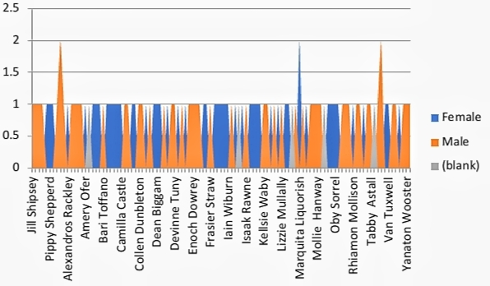
RESULTS
11

Slide 12
conclusion
Excel data modeling for salary and compensation analysis enables efficient management and insightful evaluation of salary data. By leveraging structured data, advanced formulas, and visualization tools, you can:
Overall, Excel provides a robust platform for detailed salary analysis, helping organizations optimize their compensation strategies effectively.

